Slide 1
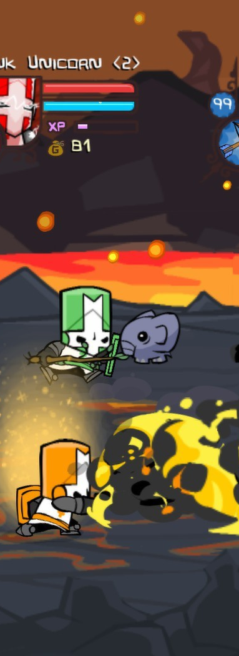

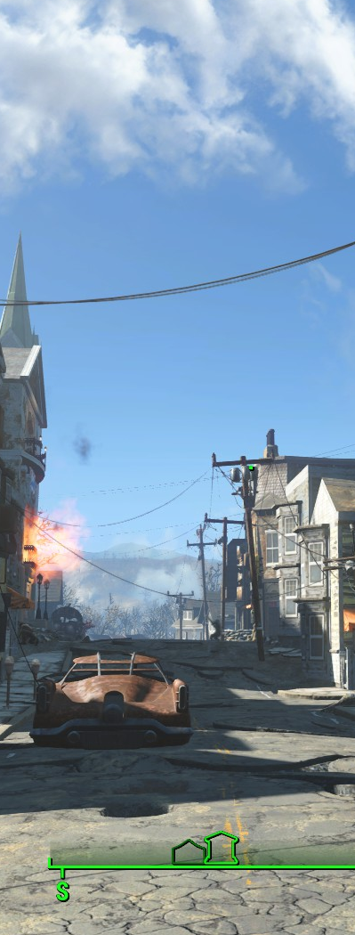

STEAMED UP
Brynne | Meg | Paul

Slide 2


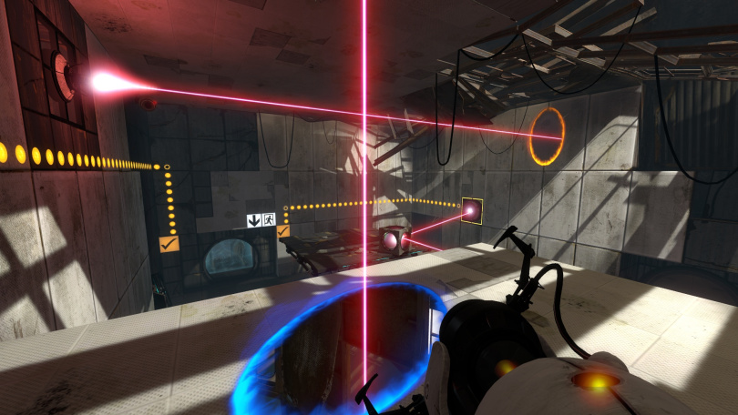
Steam is an entertainment platform from Valve offering both a storefront as well as a flexible client to game on.
Notes:
analyze regions more easily
correspond to boundaries as humans would recognize them

Slide 3

Users
Games
Community
Group
Website
{ user:
[ { game :
playtime :
...
User
API
Member
IDs
Public
IDs
Storefront
Website
App
IDs
[ { app:
{ schema :
...
Game
API
DATA COLLECTION
Notes:
Game Data
A combination of API calls and BeautifulSoup web scraping was used to collect json objects for each of the almost 16,000 games available through the Steam store. API results provided a plethora of features, the relevant including: achievements, price, genres, developers, publishers, free to play, categories, year published, game description, name, and appID. We found these features to be lacking and so scraped the storefront for user-defined tags of each game which we thought would better define similarities between games. Each of these json objects was stored as a line within a text file for further manipulation.
User Data
In order to collect user information, we first had to collect user IDs in order to make the appropriate calls to Steam’s user APIs. This was done by scraping popular Steam Community group websites for lists of member IDs. Because only information on public profiles is able to be collected, far more user IDs were collected than resulting user information (~25k users).
Each of these user IDs was then submitted through the user APIs to collect json objects containing, among other metrics, the list of games the user has in their library as well as the total amount of time they have played said games. Again, this data was stored as a text file with each user’s json results inputted as a single line.

Slide 4
MILLIONS OF USERS. THOUSANDS OF GAMES. 4 ALGORITHMS.

Slide 5

KModes
Notes:
Uses k-means clustering

Slide 6
Clustering Game Profiles
Action
F2P
RPG
Action
Racing
Adventure
166
F2P
Indie
Racing
1080
Strategy
RPG
Casual
1126
1039
176
Simulation
Strategy
Sports
Indie
Adventure
Racing
148
3
Casual
Adventure
Simulation
Design & Illustration
Audio Production
Web Publishing
1036

Slide 7
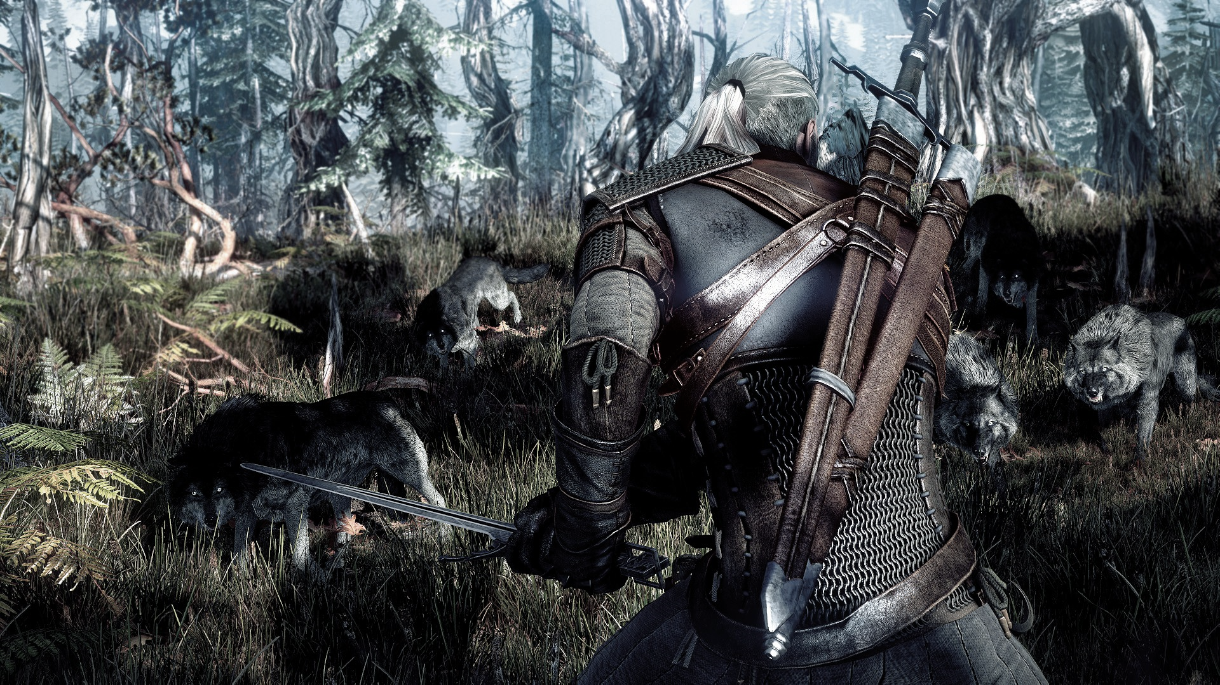
Number of Trees | Depth | Mean Square Error
70 | 4 | 1.837
100 | 4 | 1.560
120 | 4 | 1.757
100 | 6 | 1.580
Random Forest

Slide 8

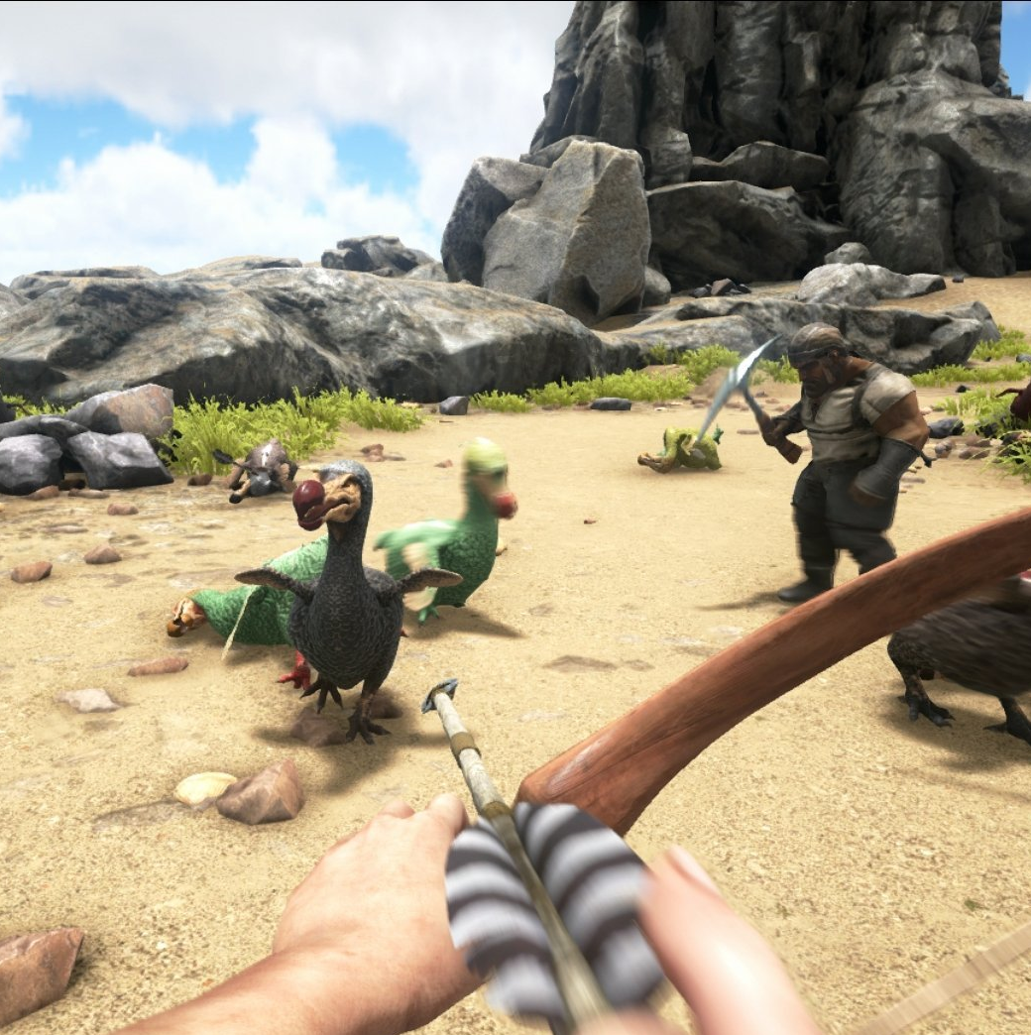

Collaborative Filtering
Notes:
Pixel Connectivity -> Hole Filling
often used in conjunction with region-growing

Slide 9
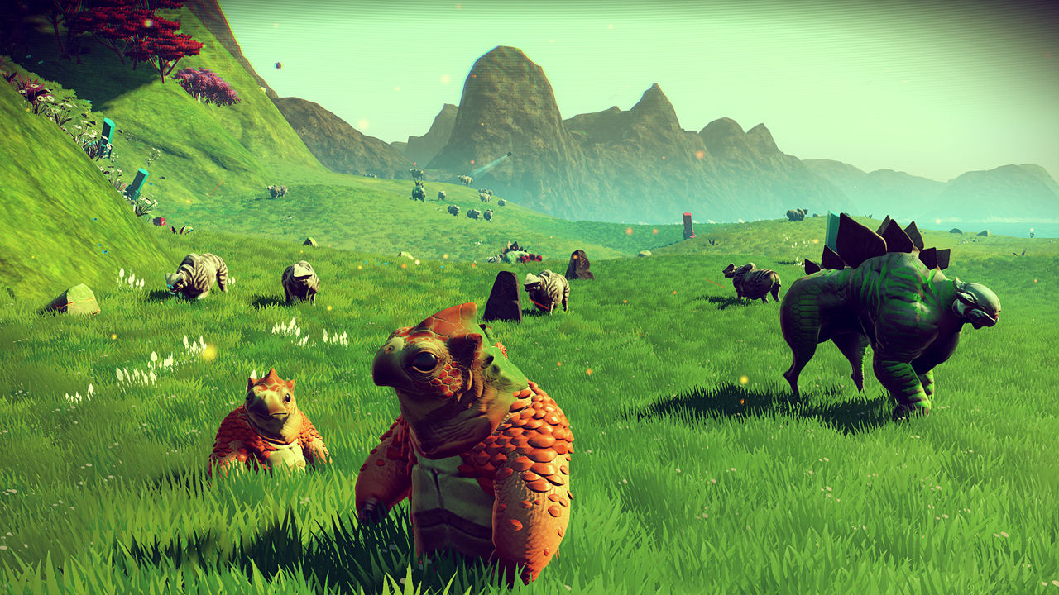

Method | Mean Absolute Error | Root Mean Square Error
Untreated Ratio | .97 | 2.36
Log Ratio | .18* | .24
Ratio to Discrete Rating | .92 | 1.12
Log Ratio to Discrete Rating | .93 | 1.14
CONSIDERATIONS
Huge variety playtime across users
“Super Users” skew playtime distribution
RATING
$$\frac{{user playtime}_{game}}{{average playtime}_{game}} | playtime>0$$
Notes:
This is my favourite -- LOOK AT THE CUTIE

Slide 10

Regression

Slide 11
TEST USER
Single test “super user”
Held each game out of training set one at a time and ranked predictions
BEST MODELS
Linear Regression with log(playtime + 1)
Logistic Regression
Majority of time spent on feature engineering.

Slide 12

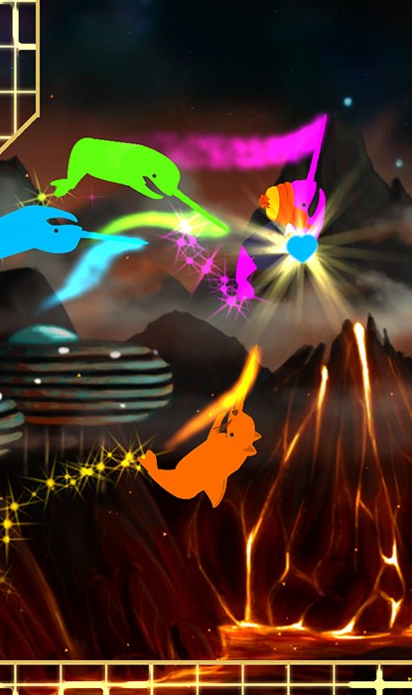
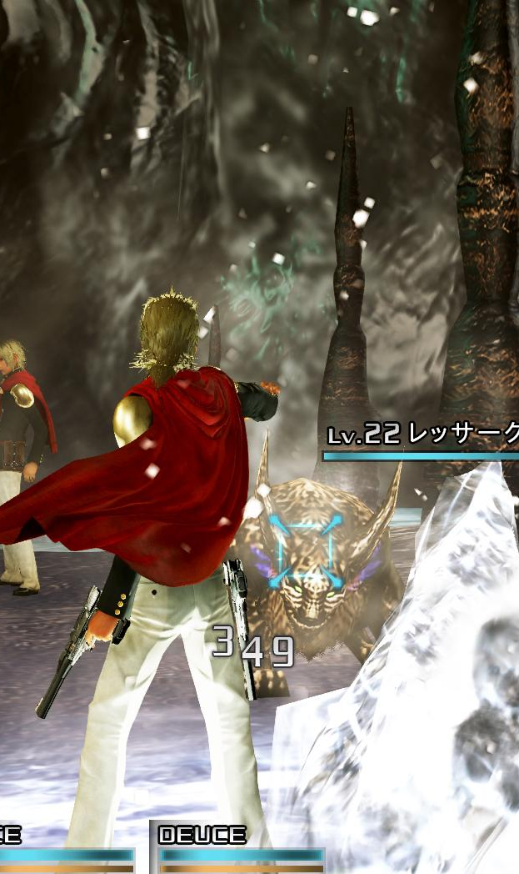
Example Comparison
Notes:
Pixel Connectivity -> Hole Filling
often used in conjunction with region-growing

Slide 13

Our Test User
Payday 2
Warframe
Team Fortress 2
Left 4 Dead 2
Total War: ATTILA
Total War: Shogun 2
Global Agenda
Tera
Payday: The Heist
Killing Floor
Fallout: New Vegas
Company of Heroes: Opposing Fronts
Total War: Rome II - Emperor Edition
Dynasty Warriors 8
Grand Theft Auto V
Fallout 4
Firefall
Left 4 Dead
Tom Clancy’s Rainbow Six Siege
Dead Island
Top Categories
1. Single-player
2. Mods
3. Co-op
Top Tags
1. Multiplayer
2. Adventure
3. Shooter
Top Genres
1. Action
2. Indie
3. Strategy
Notes:
Single-player
Mods
Co-op
Action
Indie

Slide 14
Random Forest
Log-transformed Playtime
Road Redemption
Hands on Deck
Spartans Vs. Zombies Defense
Astro Lords
CaesarIA
Galcon 2
Battle for Blood
Simply Chess
Demise of Nations: Rome
Not the Robots
Collaborative Filtering
Binned Ratio of Ratings
VERLIES II
Pilot Crusader
Masterspace
DvDrum, Ultimate Drum Simulator!
Herding Dog
Mystic Towers
RaySupreme 3D
Dandelion - Wishes brought to you
Cheesecake Cool Conrad
Rise: Battle Lines
Linear Regression
Log-transformed Playtime
Fallout 3
Red Faction: Armageddon
Dead Island Riptide
The Witcher Adventure Game
Metro: Last Light Redux
Super Sanctum TD
The Witcher: Enhanced Edition
Command and Conquer 4: Tiberian Twilight
MEDIEVAL: Total War\u2122 - Gold Edition
Summoner

Slide 15
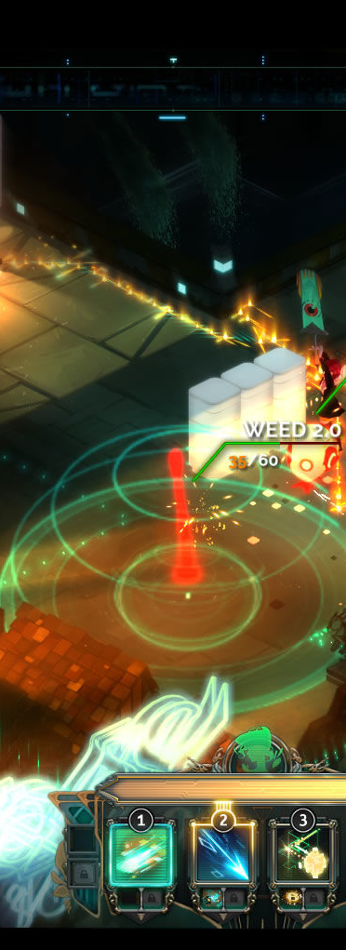


THANK YOU.

